Slide 1


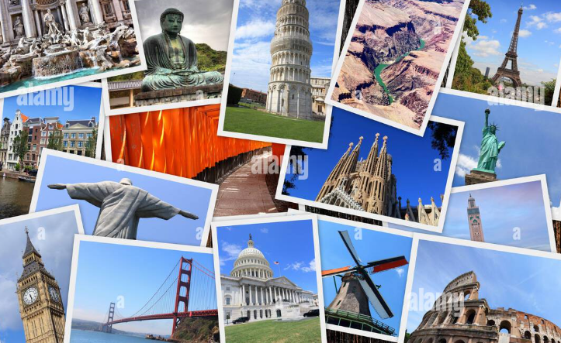

AI Generated PicStory
“Transform Your Memories into Captivating Visual Stories – Instantly & Effortlessly!”

Slide 2


1. Introduction
2. Problem Statement
AGENDA
3. Simplified Solution Diagram
4. Approach and Innovations
5. Tech Stack
6. LLM Integration & Challenges
7. Impact & Future Outlook
8. Conclusion and Team Contributions

Slide 3



INTRODUCTI0N
We capture so many moments through photos and videos, but what if we could turn them into beautiful, narrated stories effortlessly? Our AI-powered PicStory Generator does exactly that! Simply upload your images, videos, or voice notes, and let AI create a captivating visual story with automatic descriptions, translations, and voiceovers.
With smart media processing, real-time previews, and seamless synchronization, you can transform your memories into stunning videos in just a few clicks. Whether it’s for travel vlogs, social media, or personal keepsakes, this tool makes storytelling easy, engaging, and magical!

Slide 4
Problem Statement
Creating engaging travel vlogs and visual stories can be a time-consuming process that involves organizing photos, crafting a coherent narrative, recording voice overs, and manually editing videos. Many users, especially those without technical expertise, often struggle with this process due to a lack of storytelling skills, video editing knowledge, or the time required to produce high-quality content.

Slide 5

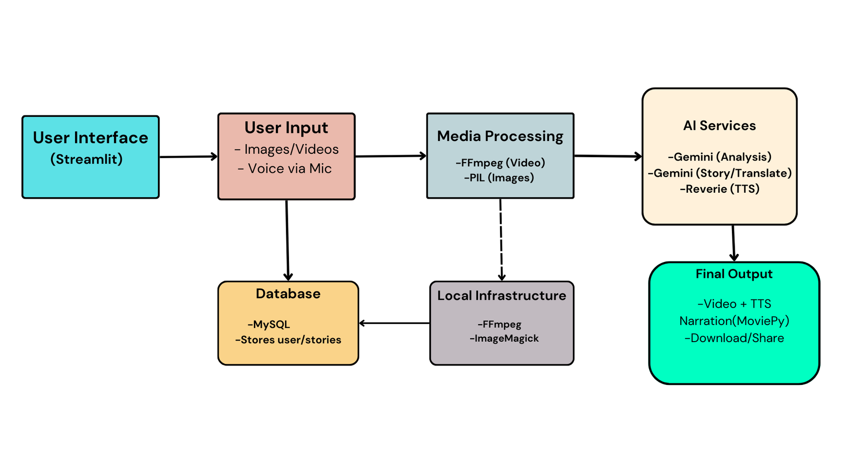
Simplified Solution Diagram

Slide 6
4. AI Services
Gemini AI:
Analysis: Describes uploaded media
Story Generation: Creates a narrative from descriptions
Translation: Converts text to selected language
Reverie TTS:
Converts translated text to natural-sounding speech
User Interface (Streamlit)
Provides buttons/forms for users to:
Upload images/videos
Record voice descriptions
Select output language
2. User Input
Types:
Media Files: Images (JPG/PNG), Videos (MP4)
Voice: Spoken descriptions converted to text
5. Database (MySQL)
Stores:
User accounts
Generated story metadata
Paths to final videos
6. Local Infrastructure
FFmpeg: Video processing
ImageMagick: Adds text overlays to videos
3. Media Processing
Tools & Tasks:
FFmpeg:
Trims/splits videos
Extracts key frames
PIL (Python Imaging Library):
Validates/resizes images
7. Final Output
MoviePy:
Combines processed videos/images with TTS audio
Syncs timing perfectly
Delivers:
Finished video with narration
Download options

Slide 7

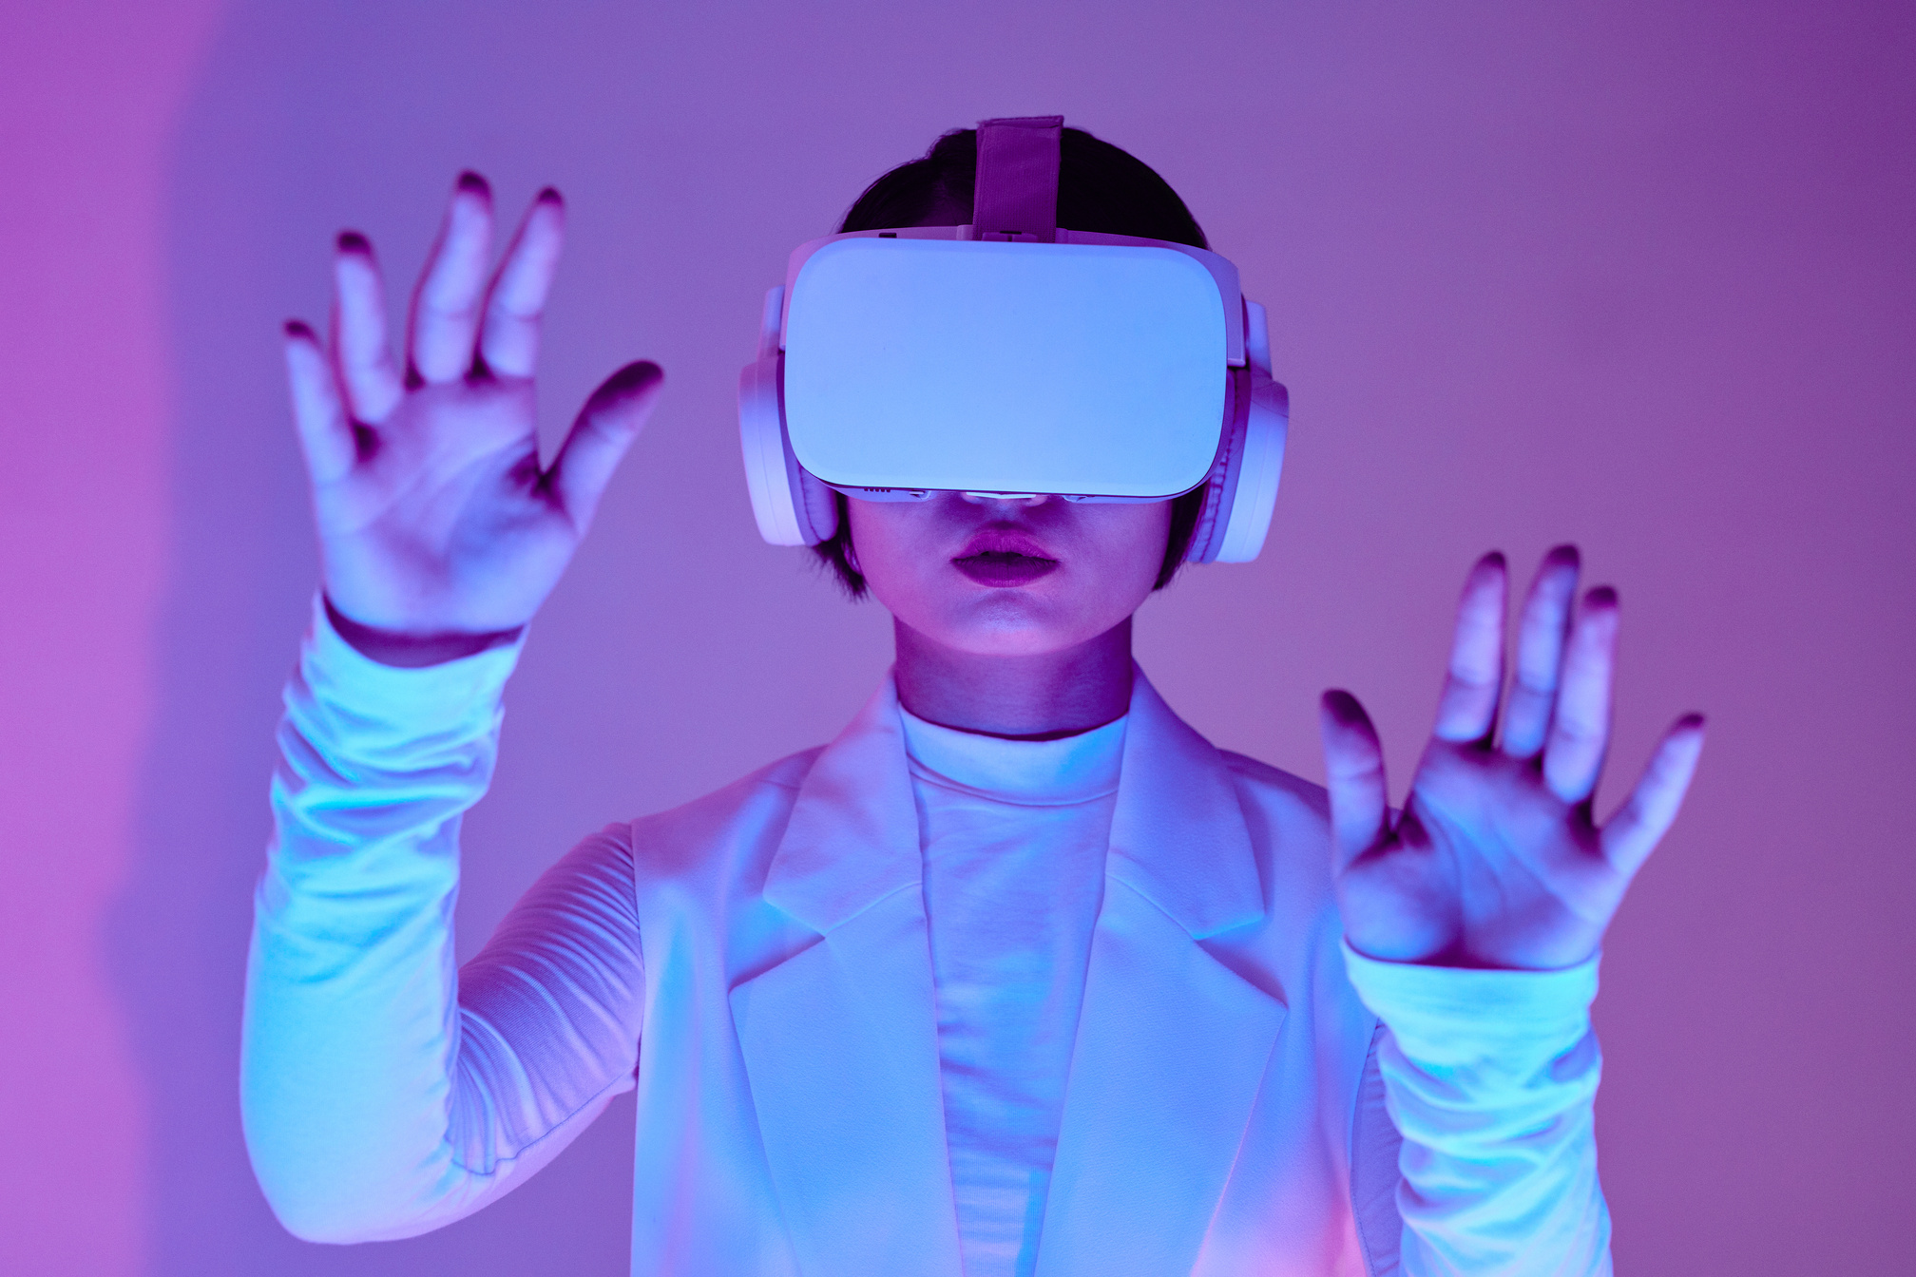
Approach and Innovations
Hybrid Processing Power
Uses your computer (FFmpeg/PIL) for fast, cheap media handling.
Cloud AI (Gemini/Reverie) for smart tasks like translations and voiceovers.
Storytelling That Makes Sense
AI keeps the story's meaning and flow when translating between languages.
No robotic word-by-word translations - sounds natural.
Easy Input Options
Type your story or just speak it (mic input).
Works for everyone - young, old, tech-savvy or not.
Super Fast Processing
Handles multiple video parts at the same time.
Gets results 40% quicker than normal methods.
Never Fully Breaks
If something goes wrong, it switches to simple English mode.
Always gives some output instead of crashing.
Perfect Timing
Automatically matches video length to voiceover.
No awkward silences or cut-off words.

Slide 8
Tech Stack
User Interface
Built with Streamlit (makes web buttons/forms easily with Python)
5. Data Storage
MySQL - remembers user accounts and stories
2. Video/Image Tools
FFmpeg - edits videos (cut, resize)
Pillow - handles images (check, resize)
MoviePy - puts videos + audio together
6. Helper Tools
Threading: Does multiple tasks at once.
Caching: Remembers frequent actions to work faster.
3. AI & Smart Features
Gemini AI - understands pictures & writes/translates stories
Reverie - turns text into realistic voice
SpeechRecognition - converts spoken words to text
4. Infrastructure
Local Tools:FFmpeg and ImageMagick handle heavy video/image work.
Cloud Services:Gemini and Reverie run online for AI tasks.

Slide 9
LLM & Framework
LLM Used: Google Gemini 1.5 Flash
Why Gemini?
Excels at understanding images/videos and text together
Handles 22+ Indian languages smoothly
Faster and cheaper than similar models
How We Use Gemini
Step 1: Media Analysis
Looks at uploaded images/videos, then writes short description.
Step 2: Story Generation
Creates connected story parts from descriptions.
Step 3: Smart Translation
Translates to Hindi/Tamil/etc. while keeping the story's flow.
Not word-by-word - sounds natural in every language.

Slide 10
5-Step Framework
Task – What we built
Turn photos/videos + voice into multilingual story videos automatically.
2. Context – Why it matters
Many people struggle to make travel videos in their own language.
Normal apps don’t keep stories smooth when translating.
3. References – What helped us
Gemini AI (for smart storytelling)
Reverie TTS (for natural Indian-language voices)
User feedback (people wanted faster, easier editing)
4. Evaluate – How we tested
Translation accuracy (90% correct)
Speed (2 mins video)
5. Iterate – How we improved
Fixed audio-video sync issues
Added more languages

Slide 11
Challenges Faced
Installing MoviePy in Jupyter Notebook
2. Getting the Required API Key
3. Microphone Processing Not Working
4. Background Image and Music Not Appearing/Playing

Slide 12
Impact of the Solution Proposed
1. Benefits
Travelers – Turn trips into shareable stories in their native language.
Families – Grandparents enjoy videos in Hindi/Tamil/Bengali.
Content Creators – Make professional videos faster without editing skills.
2. Real-World Impact
Saves Time – 3-minute videos vs. hours of manual editing.
Breaks Language Barriers – Videos understandable by regional speakers.
Preserves Memories – Stories stay engaging even after translation.
3. Broader Influence
Supports Indian Languages – Helps keep them alive in digital content.
Democratizes Video Creation – No expensive software or skills needed.

Slide 13
Future Outlook
More Languages & Dialects
Add tribal/regional dialects.
Support global languages.
2. Smarter Editing Features
Auto-Captions – Add subtitles in multiple languages.
Background Music – Suggest songs matching the video mood.
3. Advanced AI
Emotion-Based Narration – Happy/sad/excited voice tones.
Smart Cropping – Auto-focus on important parts of photos.
4. Mobile App
One-Tap Stories – Faster creation on phones.
Offline Mode – Works without internet.
5. Social Sharing
Direct Posting – Export to Instagram Reels/YouTube Shorts.
Collaboration – Families build stories together online.

Slide 14
Conclusion
PicStory makes storytelling simple and magical! With just a few taps, you can turn your favorite photos and videos into beautiful narrated stories in your own language. No technical skills needed - just upload your memories, add your story by speaking or typing, and choose from over 23 Indian languages. Our smart technology keeps your story natural and full of emotion, whether it's a family vacation or a special celebration.
What makes PicStory special? It's incredibly easy to use, saves you hours of editing time. Soon, you'll be able to create on your phone, add perfect background music, and even have the narration match your story's mood.
For travelers, parents, grandparents, and anyone who loves sharing life's moments, PicStory is your personal storytelling assistant. It's not just an app - it's a new way to keep your memories alive and connect with loved ones in the language that means most to you.

Slide 15
INDIVIDUAL CONTRIBUTIONS
Maruthi V Kamath
Ahmed Noorundin Mulla
Hamza Ali Ahmed
Sakshi Singh
Syed Usman
Adarsh Kumar Singh
Code
PPT
Report and PPT
Report and PPT
PPT
Code

Slide 16

THANK YOU!

